Slide 1










FLYING BUSINESS,
YOUR SWEETEST COPILOT
Presented by Ares-BUL-BUL Sollutions

Slide 2




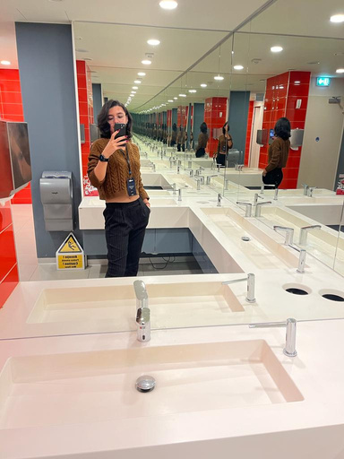
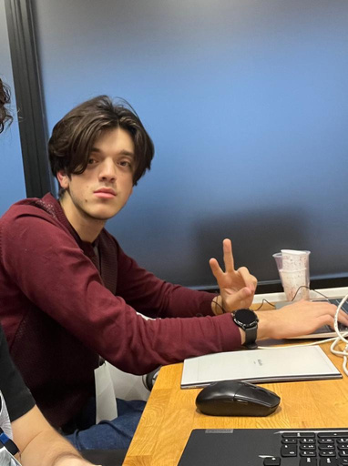
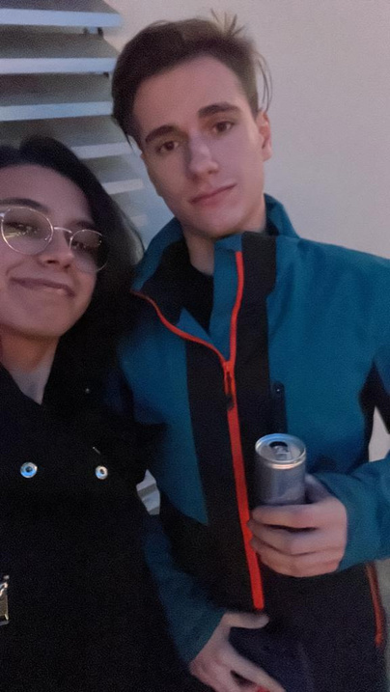

Our Team
Andreea Manole
Claudiu Alexe
Eduard Braguta
(pozele au fost facute in decursul celor 24 de ore de concurs)

Slide 3










Challenges faced by small business owners:
The challenge faced by local entrepreneurs in reaching customers beyond their immediate region
Limited resources hindering their ability to scale up promotional efforts

Slide 4


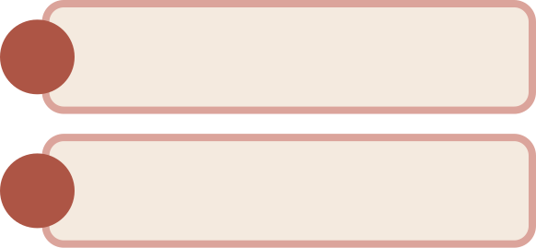

OUR SOLLUTIONS:
1.
Accessing the database in the simplest way possible to find potential customers
2.
Generating a pitch in the form of a PowerPoint using AI to target the identified specific clients.

Slide 5


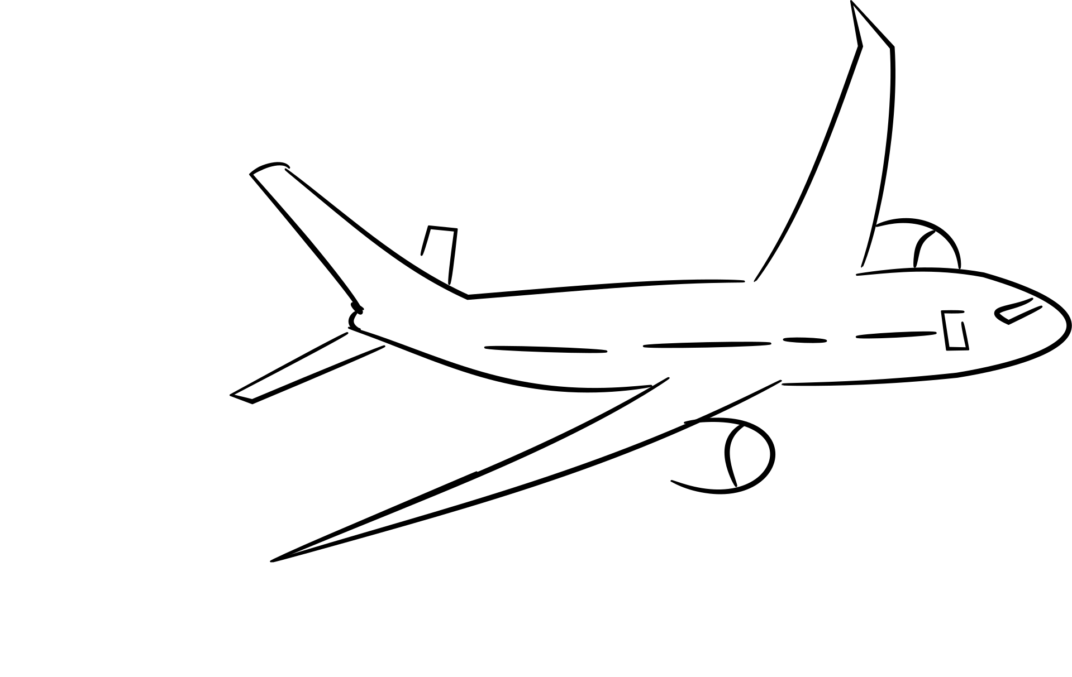


Front end:
Search
Clients
View
Clients
BUSINESS
- WROTE IN KivyMD
- MULTISCREEN APP
LOG IN
SIGN UP
Menu
MAIN MENU

Slide 6
Back-end
1.
Server ressponsible for communcating between the data base
the AI and the front-end
2.
Data base containing, login information, and clientele information

Slide 7


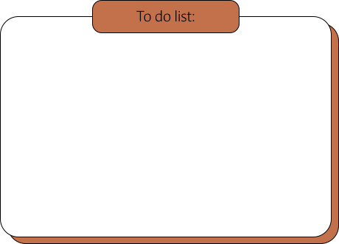
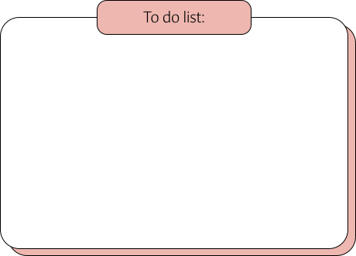


AI Processing
INPUT
OUTPUT
Information about a company's
products and geographic location
Information about possible clients,
Generations of marketing assets,
Creating a custom presentation for each customer .

Slide 8


ChatGPT
AI
HOW IT WORKS ^^
DALLE
COMPANY DATA
PRESENTATION TEXT
CUSTOM PRESENTATION
CUSTOM IMAGE SLIDES
-The user enters a promt anout what his company sells
-The ai returns some NAICS codes of possible customers
FINAL MARKET ASSETS
POWERPOINT
RELEVANT IMAGES
PICTH TEXT AS BULLETPOINTS

Slide 9
TO-DO KNOW
IMPROVE GRAPHIC USER INTERFACE
ADD MORE FILTERS FOR THE CLIENTS
IMPROVE PROMT ENGINEERING FURTHER
IMPROVE PRESESNTATION GENERATION

Slide 10







Question Time

Slide 11







